Slide 1
Multi-Agent Path Finding for Large Agents
Jiaoyang Li, Pavel Surynek, Ariel Felner, Hang Ma,
T. K. Satish Kumar and Sven Koenig
University of Southern California
Czech Technical University
Ben-Gurion University

Slide 2




Multi-Agent Path Finding (MAPF)
Notes:
Define MAPF

Slide 3
Multi-Agent Path Finding (MAPF)

Slide 4
Multi-Agent Path Finding (MAPF)

Slide 5
Multi-Agent Path Finding (MAPF)

Slide 6
Multi-Agent Path Finding (MAPF)

Slide 7
Multi-Agent Path Finding (MAPF)

Slide 8
Multi-Agent Path Finding (MAPF)

Slide 9
Multi-Agent Path Finding (MAPF)

Slide 10
Multi-Agent Path Finding (MAPF)

Slide 11
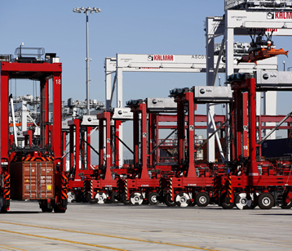
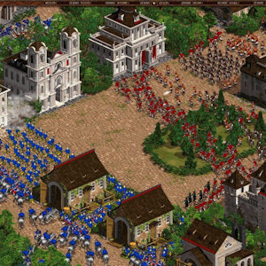
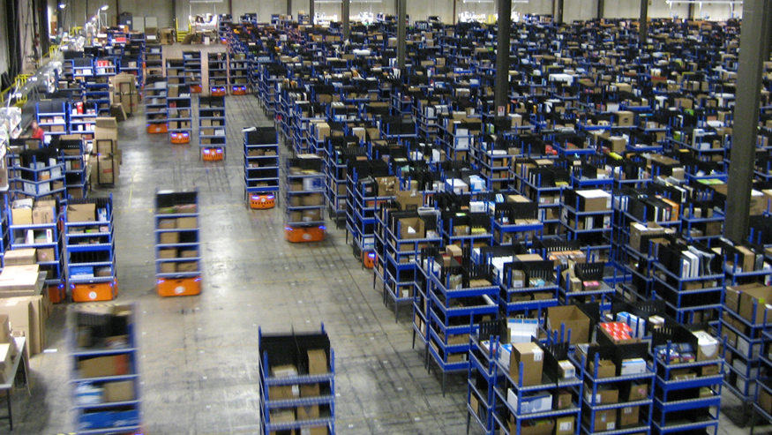
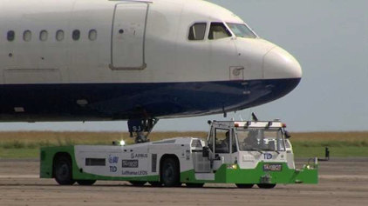
Motivation
Video games;
Automated ports;
Warehouse Robots;
Towing vehicles;
…

Slide 12
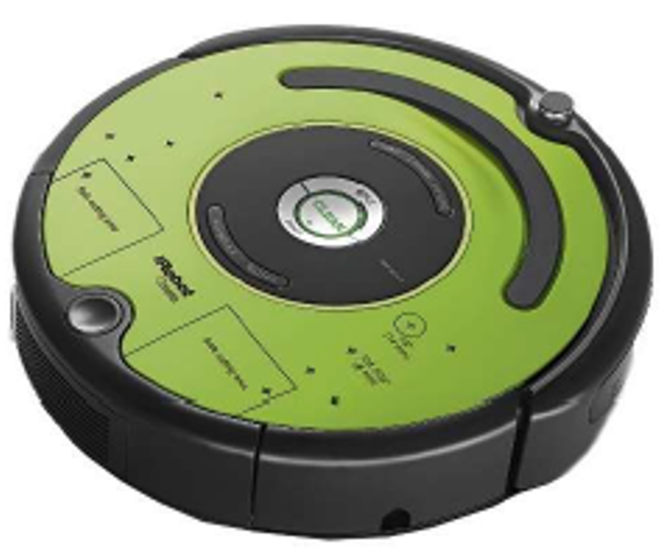
Multi-Agent Path Finding (MAPF)
Robot
Agent
Simplifying assumptions
Point agents
No kinematic constraints
Discretized environment
Point agent assumption:
degrade the resolution of discretization of the environment;
demand conflict resolution at the execution phase.

Slide 13
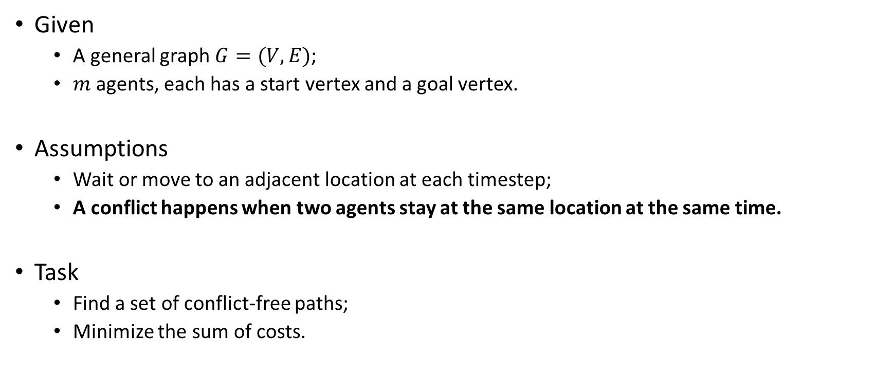
Multi-Agent Path Finding (MAPF)
Given
A general graph $G=(V,E)$;
$m$ agents, each has a start vertex and a goal vertex.
Assumptions
Wait or move to an adjacent location at each timestep;
A conflict happens when two agents stay at the same location at the same time.
Task
Find a set of conflict-free paths;
Minimize the sum of costs.

Slide 14
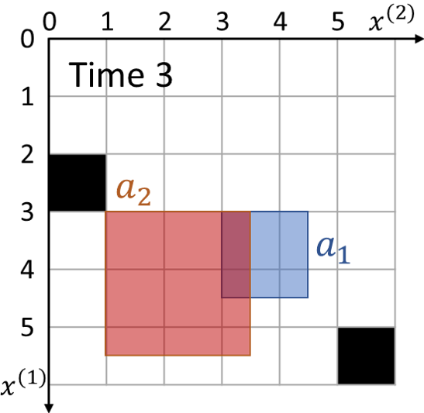
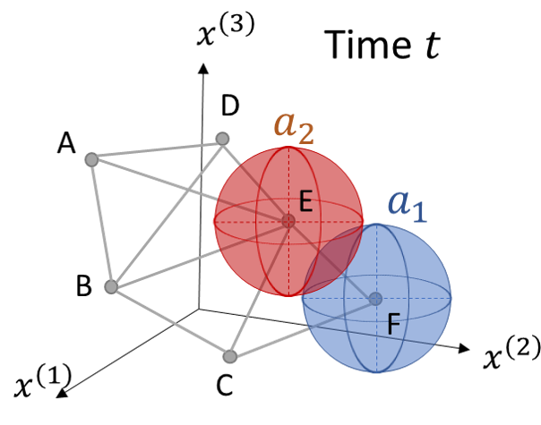
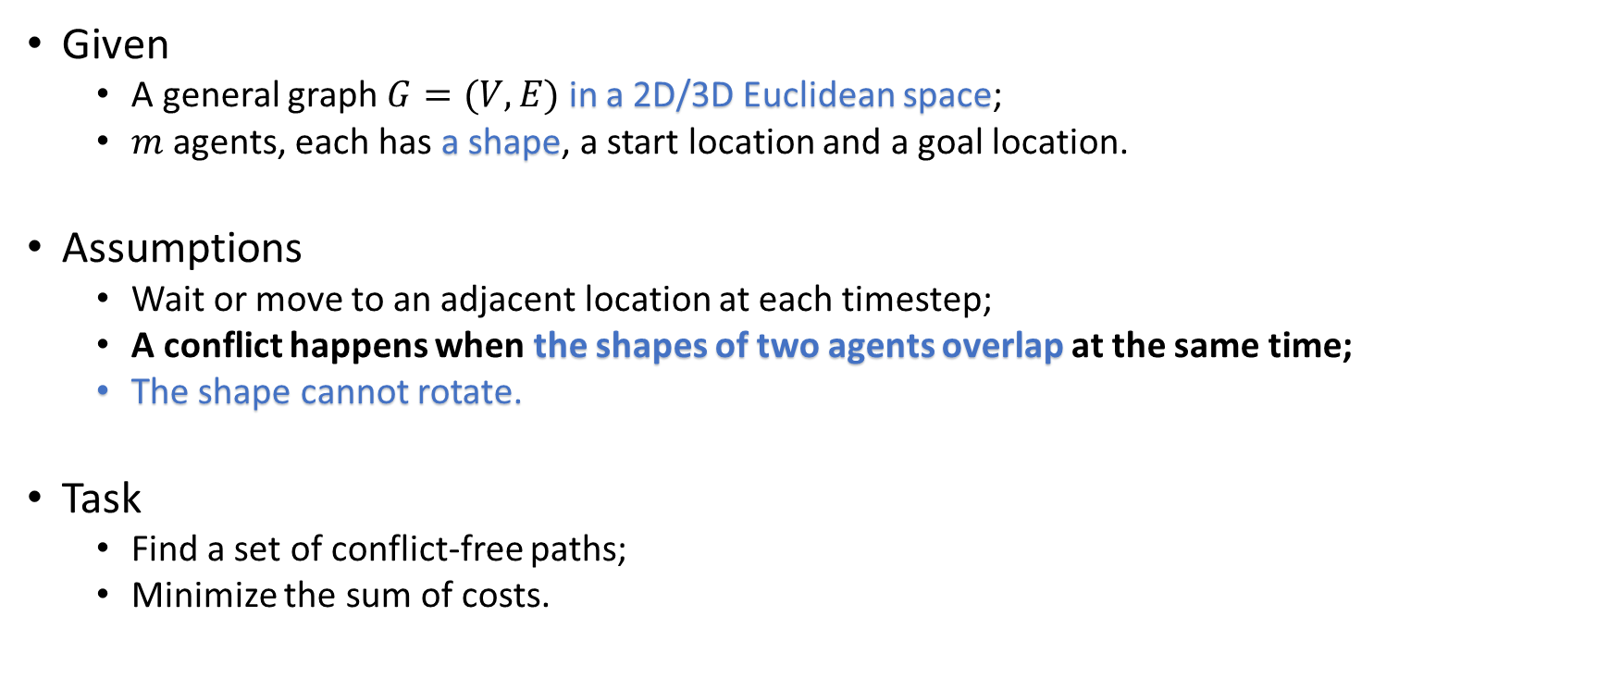
Multi-Agent Path Finding for Large Agents (LA-MAPF)
Given
A general graph $G=(V,E)$ in a 2D/3D Euclidean space;
$m$ agents, each has a shape, a start location and a goal location.
Assumptions
Wait or move to an adjacent location at each timestep;
A conflict happens when the shapes of two agents overlap at the same time;
The shape cannot rotate.
Task
Find a set of conflict-free paths;
Minimize the sum of costs.

Slide 15
Conflict-Based Search (CBS)
Find paths for every agent independently
Check conflicts in paths
If there is a conflict <agent A, agent B, location u, location v, timestep t>:
Option 1: agent A cannot stay at location u at timestep t;
Option 2: agent B cannot stay at location v at timestep t.
constraint
<agent, location, timestep>
Constraint Set C

Slide 16
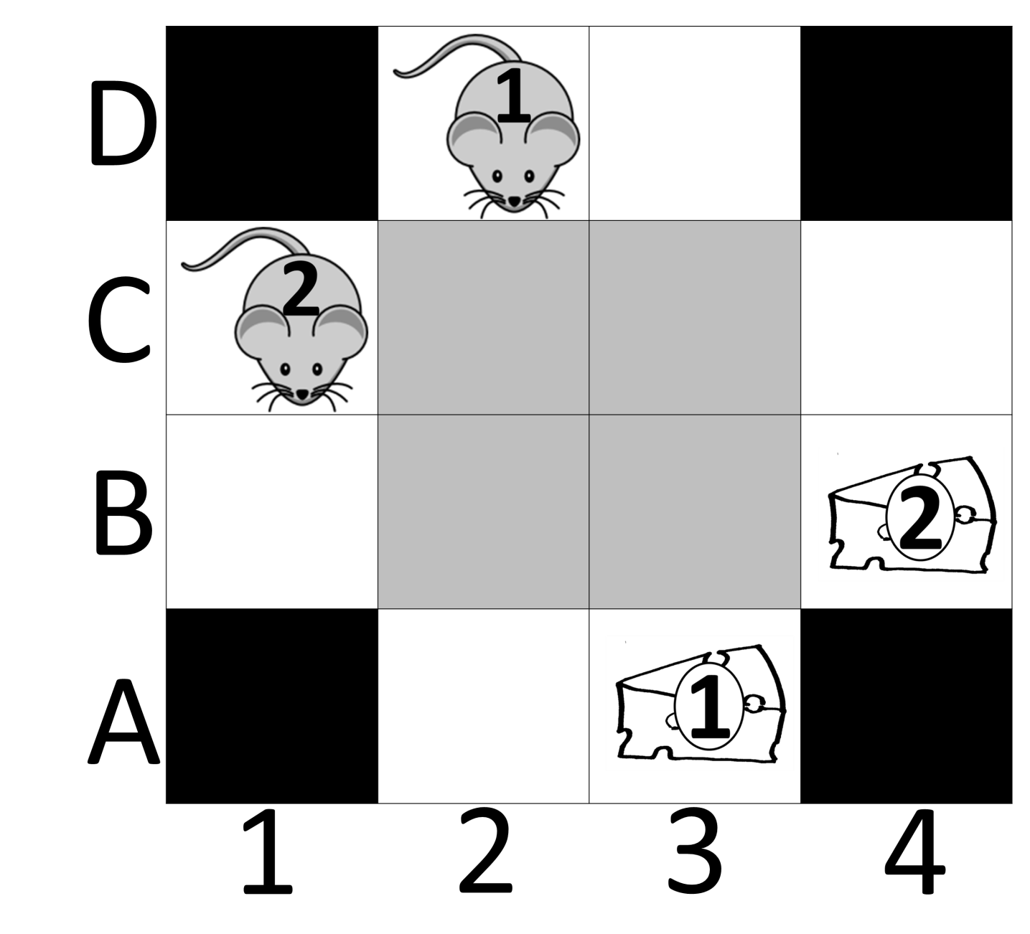
Example
Con={}
Cost = 4 + 4
D
C
B
A
 | 1 | 2 | 3 | 4
Con={<1,C2,1>}
Cost = 4 + 4
D
C
B
A
 | 1 | 2 | 3 | 4
D
C
B
A
 | 1 | 2 | 3 | 4
Con={<2,C2,1>}
Cost = 4 + 4
D
C
B
A
 | 1 | 2 | 3 | 4
D
C
B
A
 | 1 | 2 | 3 | 4
…
…
Con={<1,C2,1>,
<1,B3,3>}
Cost = 5 + 4
Con={<1,C2,1>,
<2,B3,3>}
Cost = 4 + 4

Slide 17
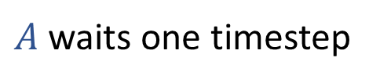








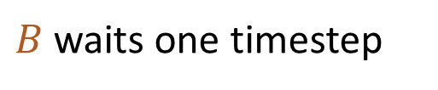
Apply CBS to LA-MAPF
$$B$$
Timestep 3
$$B$$
$$A$$
$$A$$
Timestep 3
Timestep 3
$$B$$
$$B$$
$$A$$
$$A$$
$A$waits one timestep
$B$waits one timestep

Slide 18

Apply CBS to LA-MAPF
$$B$$
Timestep 3
$$B$$
$$A$$
$$A$$
Timestep 3
$$B$$
Timestep 3
$$B$$
$$A$$
$$A$$
$A$waits one timestep
GOAL！

Slide 19
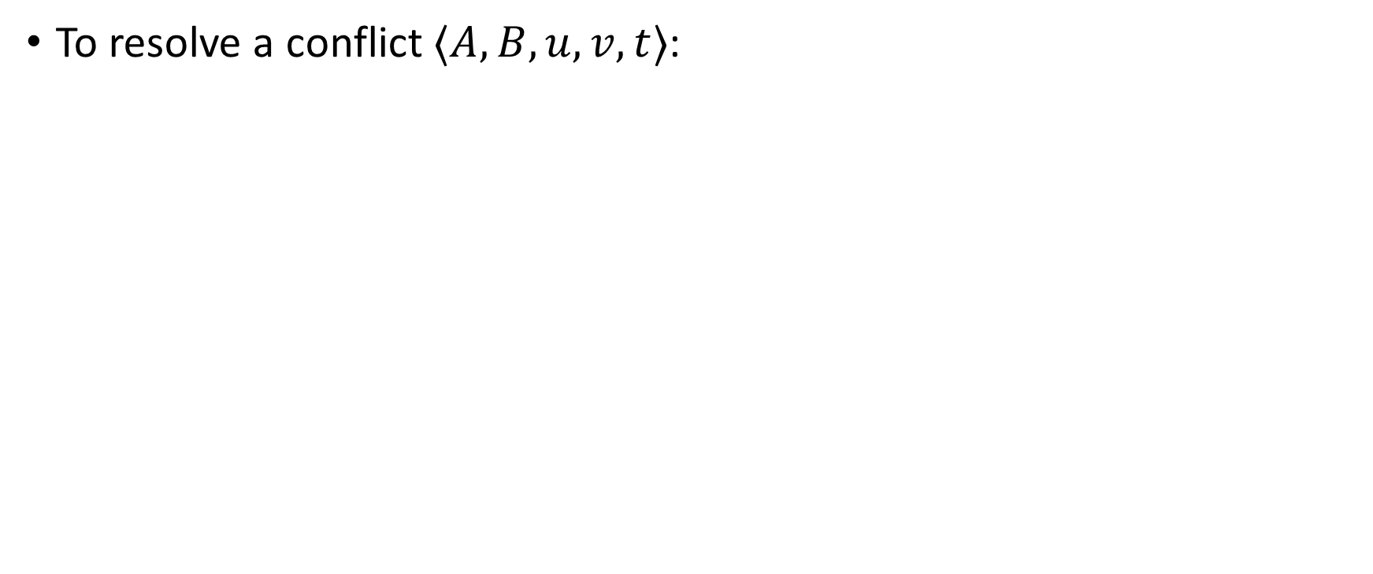
Add Multiple Constraints
To resolve a conflict $⟨A,B,u,v,t⟩$:
Standard CBS
We want
Split does not lose any conflict-free paths.
Any pair of conflict-free paths should satisfy at least one of the constraint sets.

Slide 20
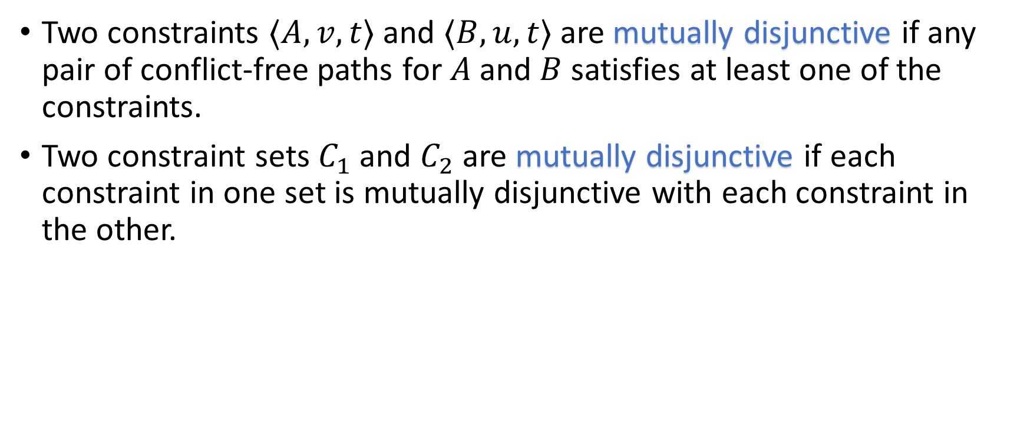
Mutually Disjunctive
Two constraints $⟨A,v,t⟩$ and $⟨B,u,t⟩$are mutually disjunctive if any pair of conflict-free paths for $A$and $B$satisfies at least one of the constraints.
Two constraint sets $C_{1}$ and $C_{2}$ are mutually disjunctive if each constraint in one set is mutually disjunctive with each constraint in the other.

Slide 21
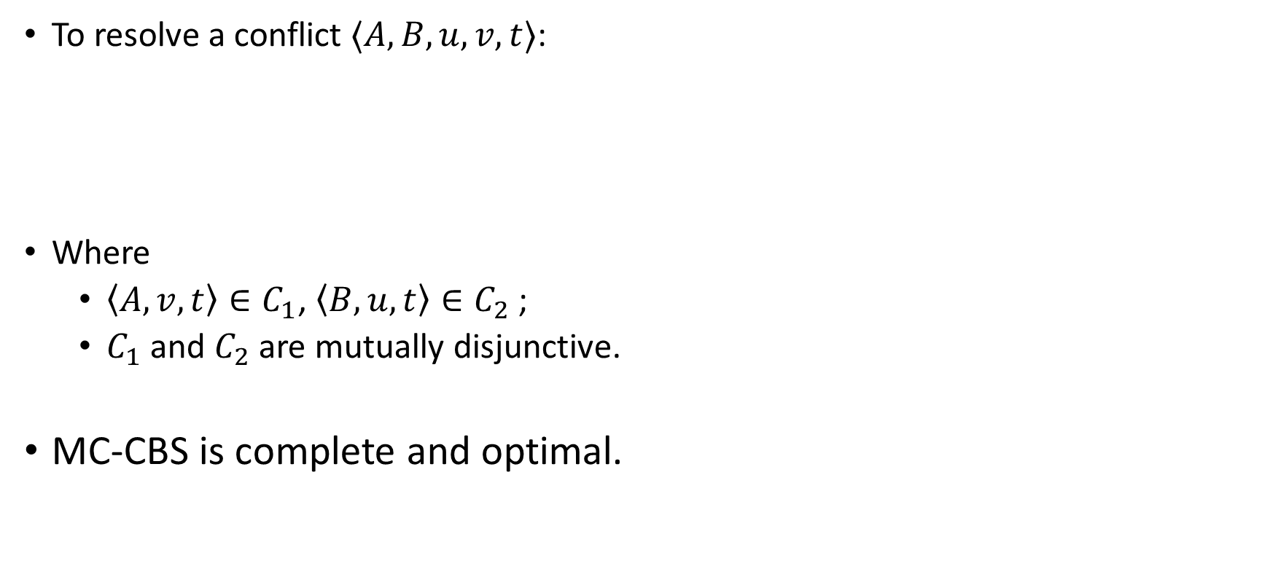
Multi-Constraint CBS (MC-CBS)
To resolve a conflict $⟨A,B,u,v,t⟩$:
Where
$\left\langle A,v,t\right\rangle ∈C_{1}$, $\left\langle B,u,t\right\rangle ∈C_{2}$;
$C_{1}$ and $C_{2}$ are mutually disjunctive.
MC-CBS is complete and optimal.

Slide 22
Choose such constraint sets:
Method 1: ASYM
Method 2: SYM
Method 3: MAX
- Add constraints to maximize the cost of child nodes.

Slide 23
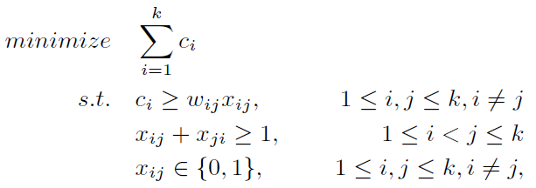
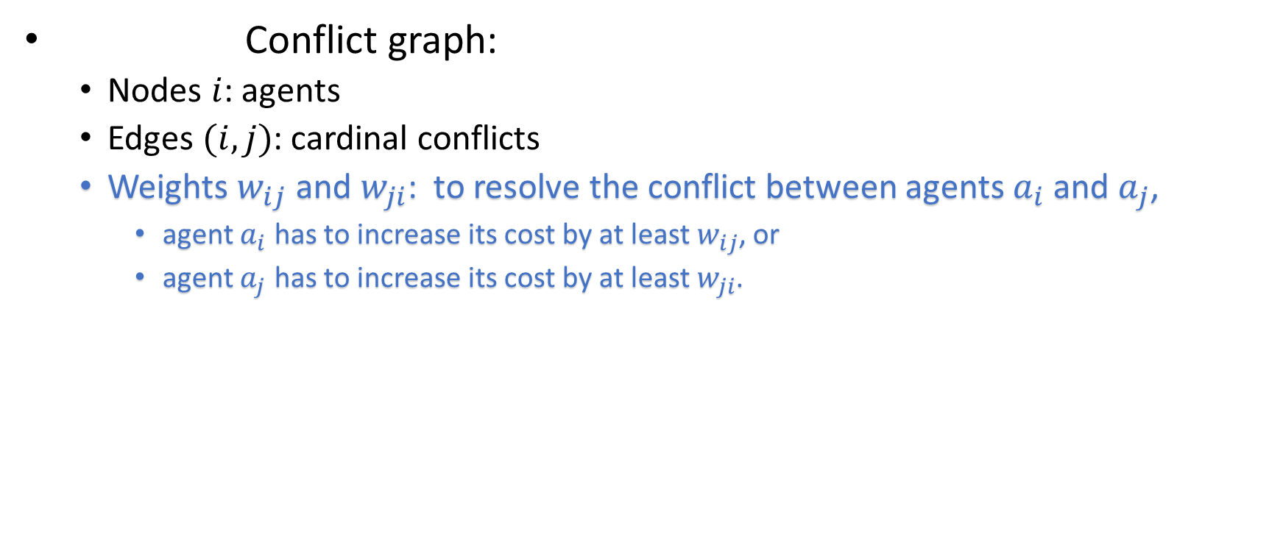
Add heuristics to the high-level search
1
Weighted
Conflict graph:
Nodes $i$: agents
Edges $(i,j)$: cardinal conflicts
Weights $w_{ij}$ and $w_{ji}$: to resolve the conflict between agents $a_{i}$ and $a_{j}$,
agent $a_{i}$ has to increase its cost by at least $w_{ij}$, or
agent $a_{j}$ has to increase its cost by at least $w_{ji}$.
2
3
4

Slide 24
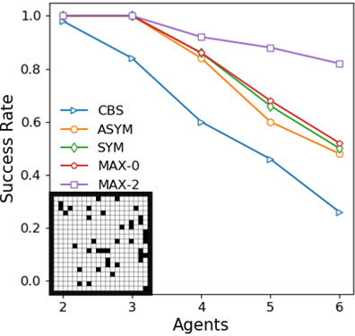
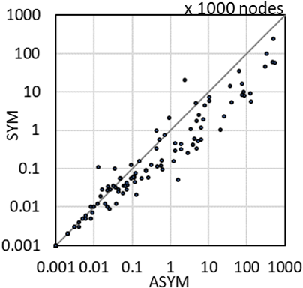
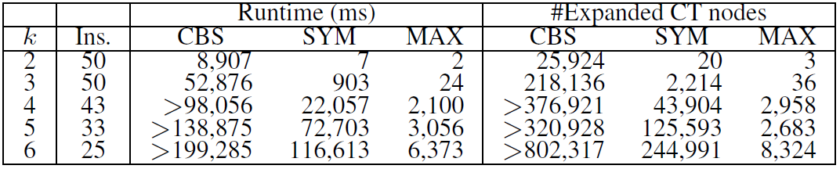
Experimental Results
20x20 grid with 10% obstacles
Agent shape: 3x3
MAX
MC-CBS
CBS

Slide 25
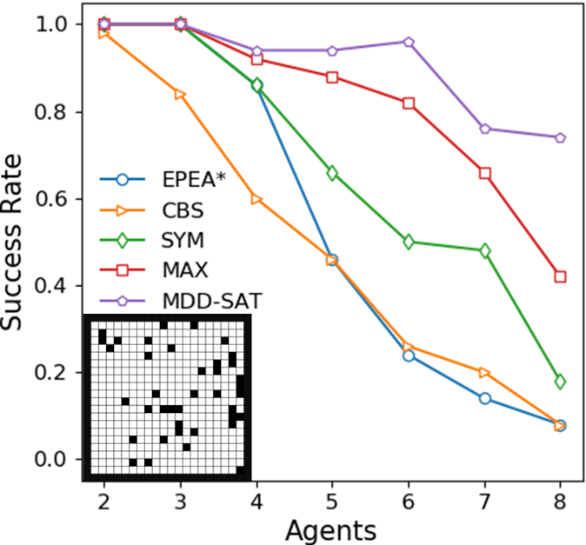
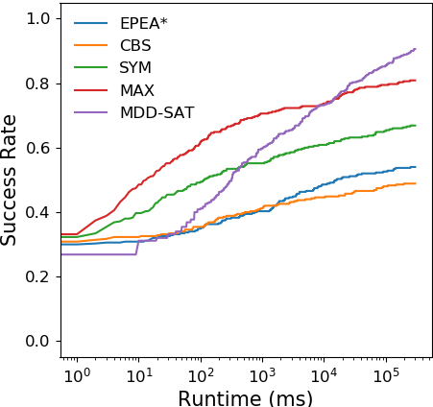
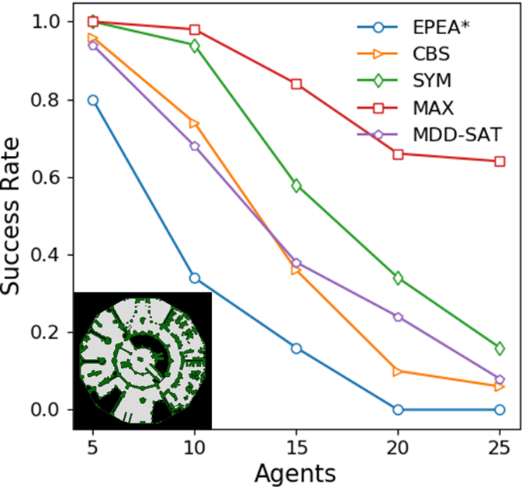
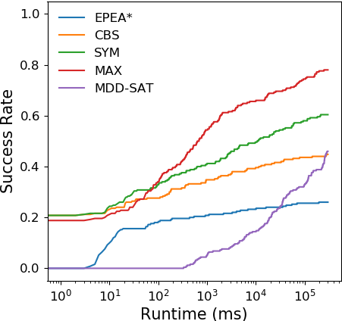
Experimental Results
Small map (20x20):
SAT
MAX
CBS
EPEA*
Large map ():
MAX
CBS
SAT
EPEA*

Slide 26
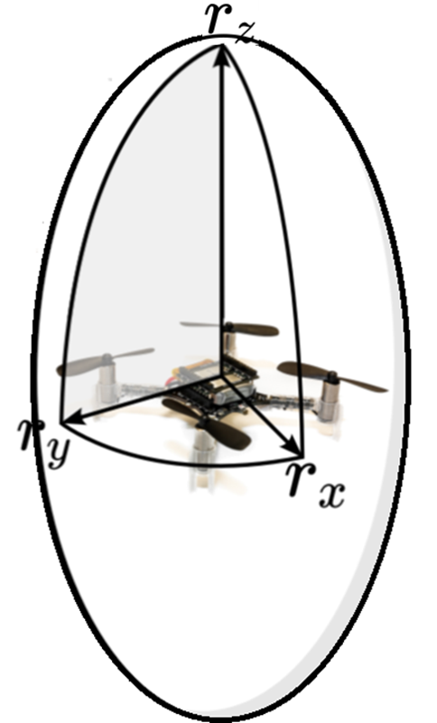
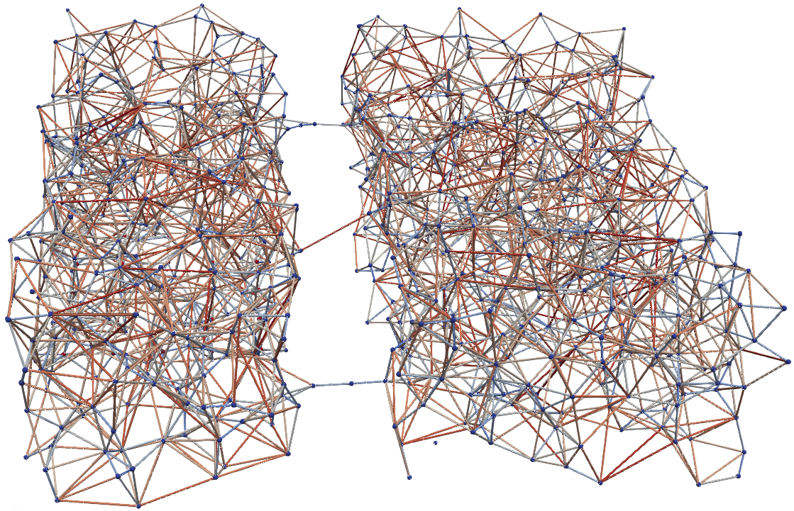
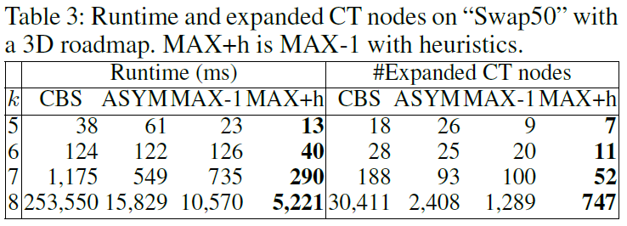
Experimental Results

Slide 27
Summary
LA-MAPF:
Consider shapes of agents
Generalize the definition of conflicts
MC-CBS:
Add mutually disjunctive constraint sets
Three approaches to choosing constraint sets
Add heuristics to the high-level search
In the future,
Allows the rotation of shapes.
Sub-optimal LA-MAPF algorithms.

